Slide 1

Institute of Aeronautical Engineering
(Autonomous)
Department of Electronics and communication Engineering
HANDWRITTEN DIGIT RECOGNITION USING CNN WITH VOICE
Supervisor Name:
Mr. A Prashanth
Assistant Professor
Electronics and communication Engineering
Batch Members
19951A04M5 – Kolluri Vishnu
19951A04N6 – M.Sai Swaroop
1995A104N1 – Yashwanth Reddy
Date: 08/12/2021

Slide 2
Abstract
People can see and visually feel the sector round them through using their eyes and brains. We want to make machines to work just like humans.
The goal of our work will be to create a model that will be able to identify and determine the handwritten digit from its image with better accuracy.
We aim to complete this by using the concepts of Convolutional Neural Network and MNIST dataset.
Though the goal is to create a model which can recognize the digits, we can extend it for letters and then a person’s handwriting.
Through this work, we aim to learn and practically apply the concepts of Convolutional Neural Networks.
We are going to add voice while displaying the output.
Keywords: CNN, MNISTdataset, ReLu, Softmax, Maxpooling, Flattened

Slide 3
Introduction
Convolutional Neural Networks (CNN) becomes one of the most appealing approaches and has been an ultimate factor in a variety of recent success and challenging machine learning applications such as challenge Image Net object detection image segmentation and face recognition.
Therefore, we choose CNN for our challenging tasks of image classification.
We can use it for handwriting digits recognition which is one of high academic and business transactions.
There are many applications of handwriting digit recognition in our real life purposes.
Precisely, we can use it in banks for reading checks, post offices for sorting letter, and many other related works.
We can use it for Handwritten digit recognition with MNIST data set.

Slide 4
REQUIREMENTS
Software required
Jupyter Notebook
Libraries used
Tensor flow
Numpy
Matplotlib
Opencv-python
TKinter

Slide 5
EXISTING BLOCK DIAGRAM
input
Convolution
+ReLu
Max pooling
Flatten
output
Recognition
Fully connected layer+softmax

Slide 6
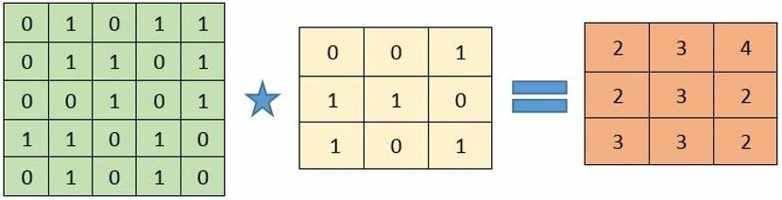
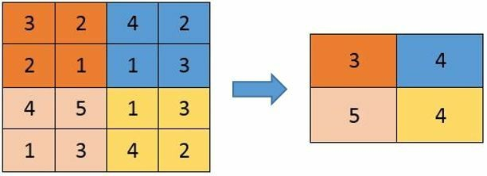
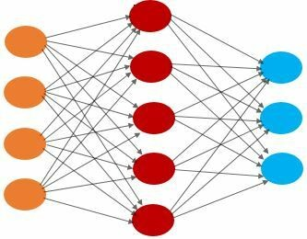
Convolution operation
Max pooling operation
Fully connected layers

Slide 7
PROBLEM DEFINED
In the existing method we need to give file name as input in order to recognize the digit but we create a interface to write and recognize the digit.
In the existing method we only display the output whereas in proposed method the output is displayed with voice.

Slide 8
PROPOSED BLOCK DIAGRAM
input
Convolution
+ReLu
Max pooling
Flatten
output
Recognition
Fully connected layer+softmax
Voice

Slide 9
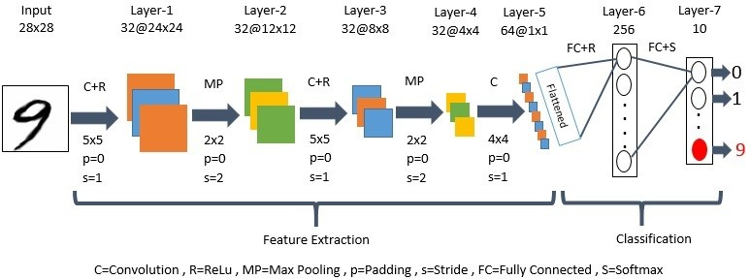
Block Diagram

Slide 10
APPLICATIONS
Postal-address
Bank-check processing
Writer Recognition

Slide 11
REFERENCES
Nimisha Jain, Kumar Rahul, Ipshita Khamaru. AnishKumar Jha, Anupam Ghosh (2017). “Hand Written Digit Recognition using Convolutional Neural Network (CNN)”, International Journal of Innovations & Advancement in Computer Science, IJIACS,ISSN 2347 – 8616,Volume 6, Issue 5.
Dr.Kusumgupta2 ,"A Comprehensive Review On Handwritten Digit Recognition Using Various Neural Network Approaches", International Journal Of Enhanced Research In Management & Computer Applications, Vol. 5,No. 5, Pp. 22-25, 2016.
Saeed AL-Mansoori, "Intelligent Handwritten Digit Recognition using Artificial Neural Network", Int. Journal of Engineering Research and Applications, vol. 5, no. 5, pp. 46-51, 2015.
Nurul Ilmi, Tjokorda Agung Budi W and Kurniawan Nur R, “Handwriting Digit Recognation using Local Binary Pattern Varience and K-Nearest Neighbor,” 2016 Fourth International Conference on Information and Communication Technologies (ICoICT).

Slide 12
Thank you

